Slide 1

CST 2105 Data Science Found. Project Presentation
CREDIT CARD APPROVAL PREDICTION _Group 5
BY: Shiya Mi
Shiyuan Zhang​
April Qianwen Fang
2023/04/05

Slide 2
PROJECT TIMELINE
WEEK 2
WEEK 4
WEEK 6-12
WEEK 13
01
02
03
04
Topic Selection
Project Proposal Submission
Project Documentation
Final Presentation

Slide 3

AGENDA
Business Understanding
Data Understanding
Data Preparation
4. Modeling and Pipelines Creation
5. Model Evaluation and Selection
6. Conclusion

Slide 4

1. Business Understanding
Background
Credit score cards are a common risk control method in the financial industry. It uses personal information and data submitted by credit card applicants to predict the probability of future defaults and credit card borrowings.
Problem statement
Generally speaking, credit card scores are based on historical data. The bank is able to decide whether to issue a credit card to the applicant. With the development of machine learning algorithms, more predictive methods such as Boosting, Random Forest, and Support Vector Machines have been introduced into credit card scoring.
Objectives
To utilize machine learning approaches to predict credit card approval based on customer information like property ownership, car ownership, number of children and family members, annual income, marital status, type of occupation, etc. We aim to build a machine learning model to predict if an applicant is 'good' or 'bad' client.
Notes:
Credit Cards are a type of loan wherein a person can borrow money from the banks and he/she is liable to repay the amount on a monthly basis.
When a person does not repay the amount on time, it not only affects that person's credit score but it also affects the banks negatively. When the banks do not get the money that they loan back, enough money is not available with them and thus they are not able to lend money to the people who urgently need money or to the people who have a good credit score.
Build a machine learning model to predict if an applicant is 'good' or 'bad' client, different from other tasks, the definition of 'good' or 'bad' is not given. Also, unbalance data problem is a big problem in this task.

Slide 5
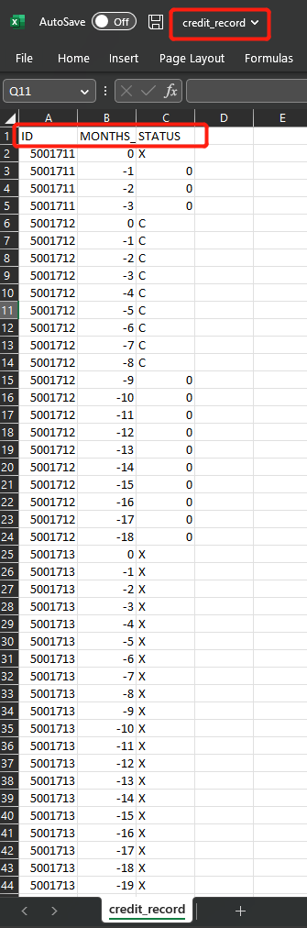
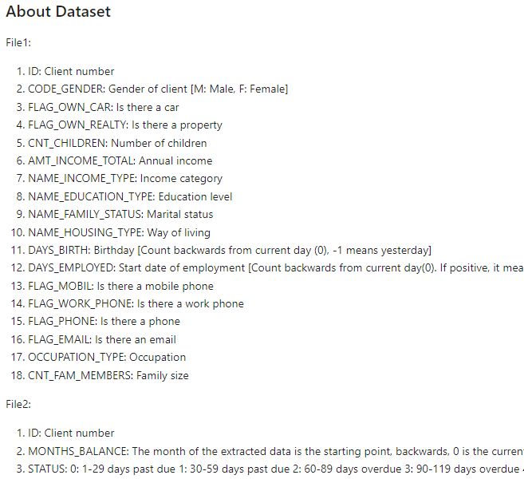
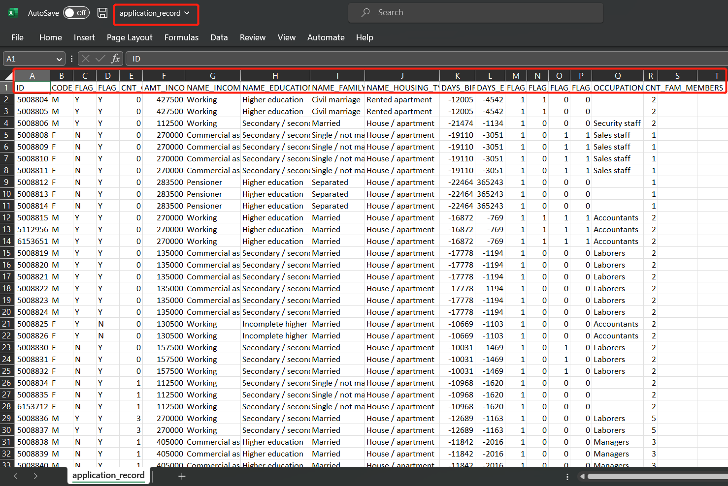
2. Data Understanding (1/11)
Data Capture and explanation : 2 datasets used
Application record
Contains general information about applicant, such as applicant gender, DOB, education type, assets, income, family status etc.)
Credit record
Contains applicant's loan payment records and status

Slide 6
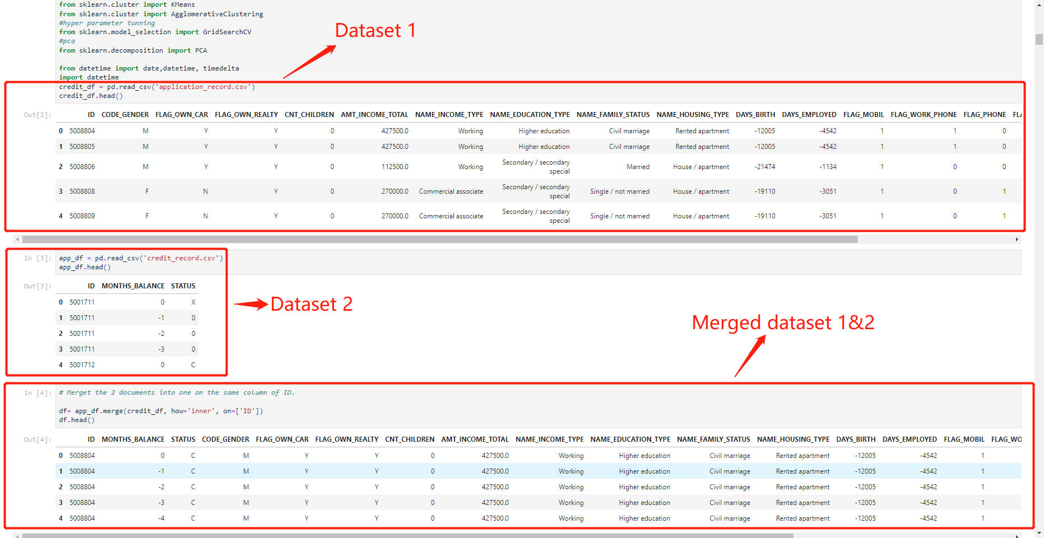
2. Data Understanding (2/11)
Data Capture and explanation:
Merge the 2 datasets into one on the same column of ID
Get a description, general information, data types, and shape of the dataset:
Rows: 777715 Features: 20

Slide 7
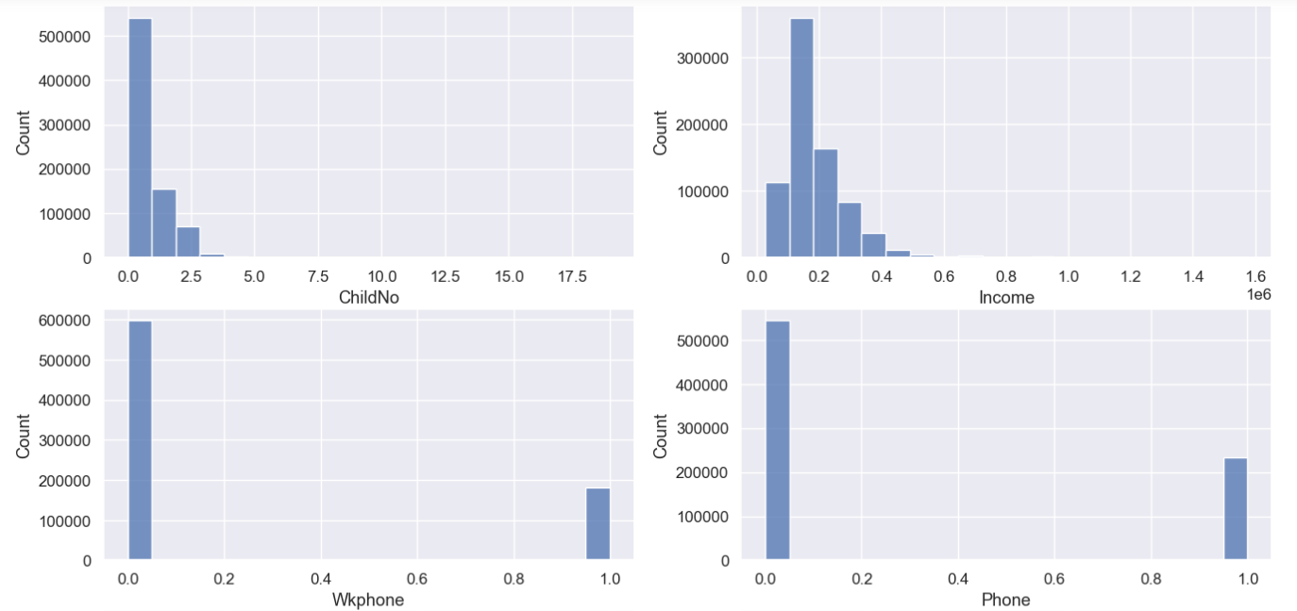
2. Data Understanding (3/11)
Data Exploration (clustering, visualization, etc.)
Plot all features in the dataset to check distribution using a histogram (numerical features)

Slide 8
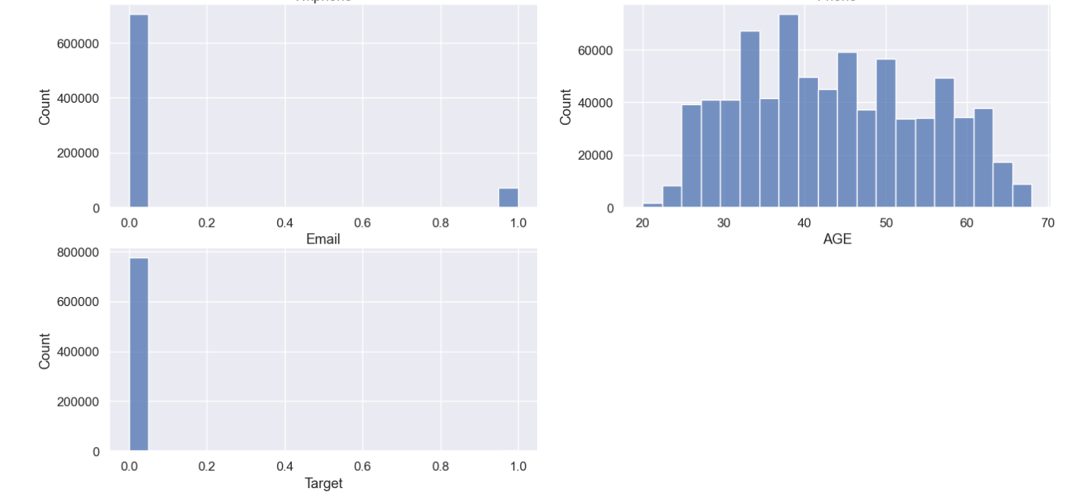
2. Data Understanding (4/11)
Data Exploration (clustering, visualization, etc.)
Plot all features in the dataset to check distribution using a histogram (numerical features)

Slide 9
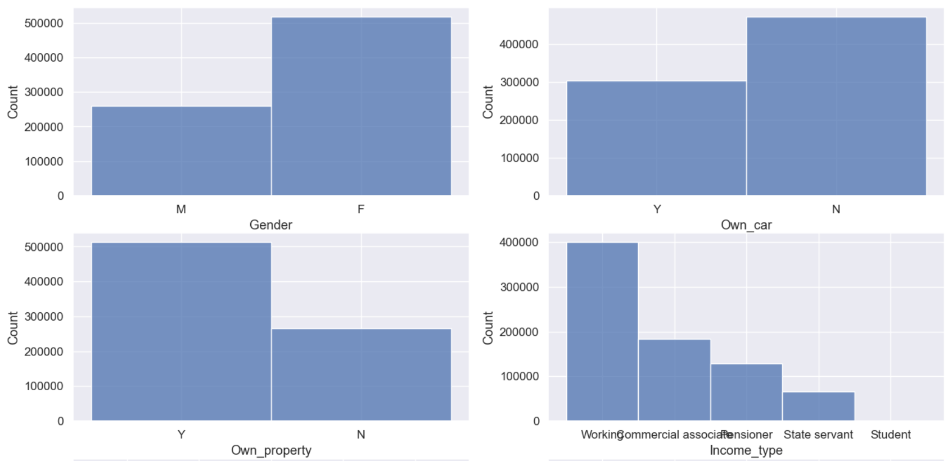
2. Data Understanding (5/11)
Data Exploration (clustering, visualization, etc.)
Plot all features in the dataset to check distribution using a histogram (non-numerical features)

Slide 10
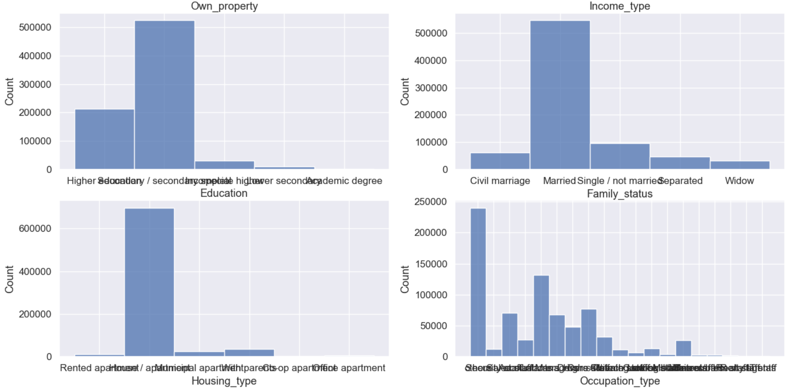
2. Data Understanding (6/11)
Data Exploration (clustering, visualization, etc.)
Plot all features in the dataset to check distribution using a histogram (non-numerical features)

Slide 11
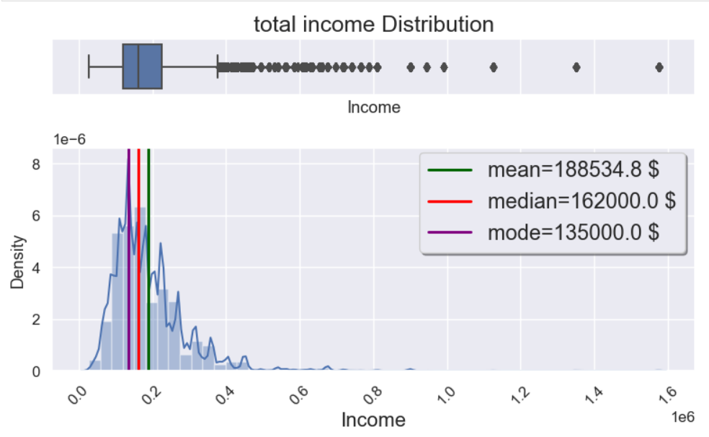
2. Data Understanding (7/11)
Data Exploration (clustering, visualization, etc.)
2) Visualize graphs to show the clustering clearly (visualize the distribution of the income)

Slide 12
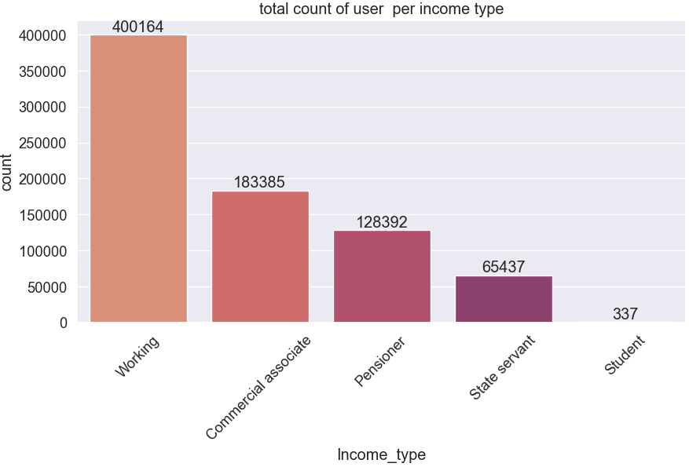
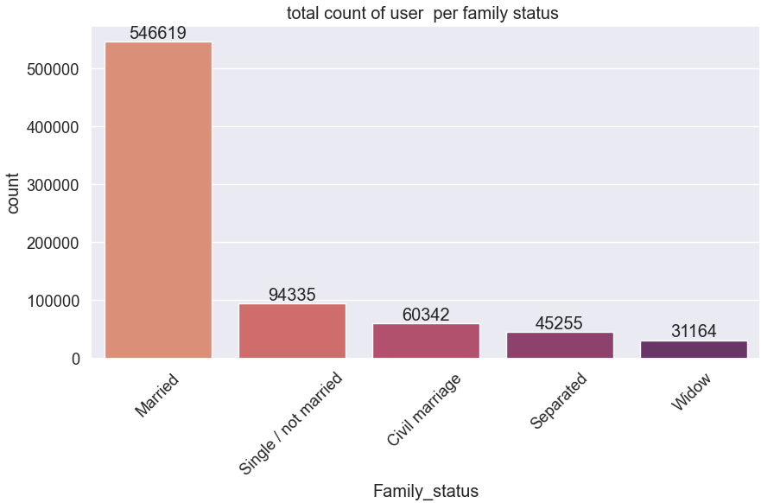
2. Data Understanding (8/11)
Data Exploration (clustering, visualization, etc.)
2) Visualize graphs to show the clustering clearly

Slide 13
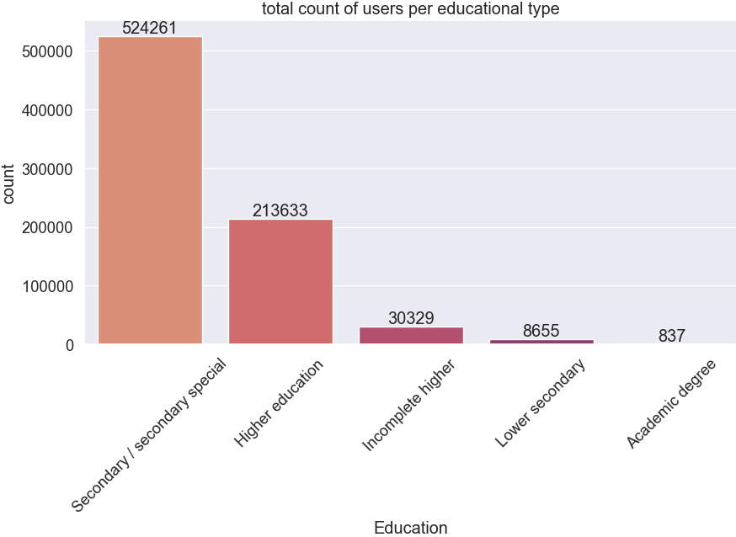
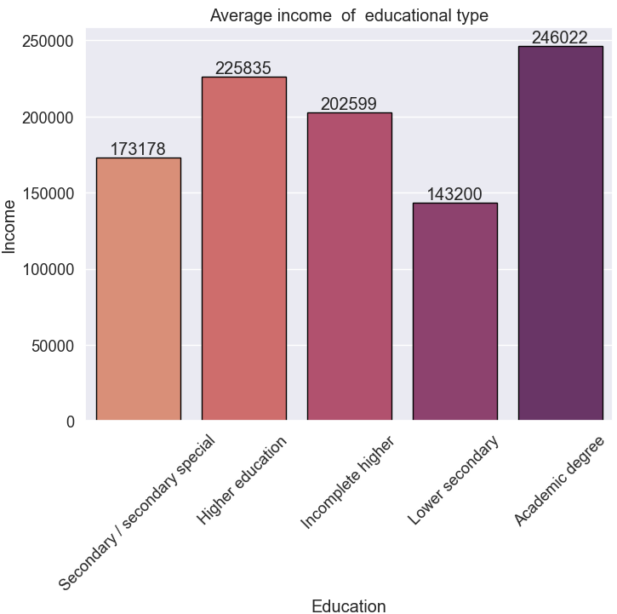
2. Data Understanding (9/11)
Data Exploration (clustering, visualization, etc.)
2) Visualize graphs to show the clustering clearly

Slide 14
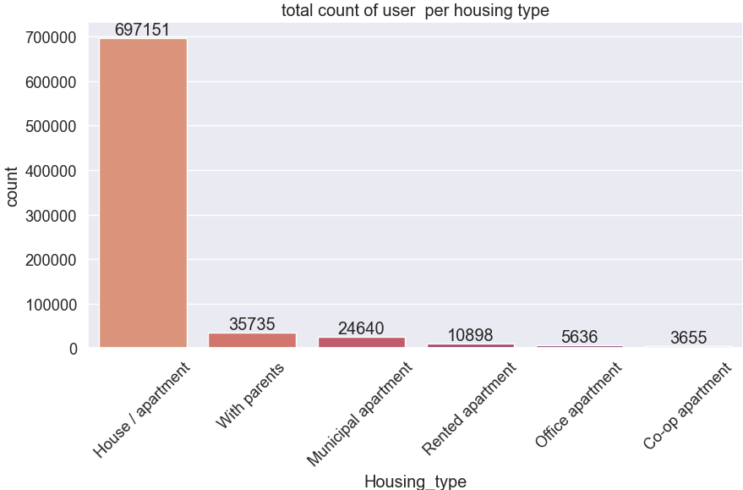
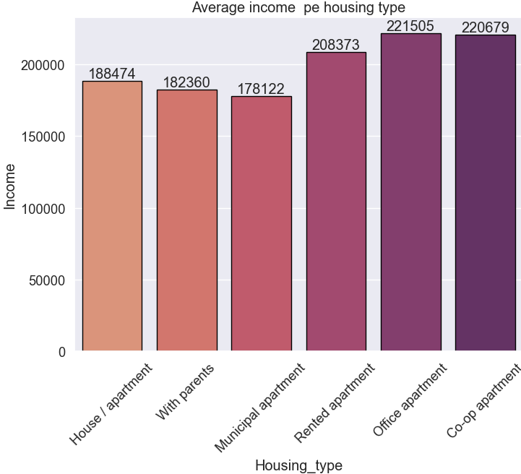
2. Data Understanding (10/11)
Data Exploration (clustering, visualization, etc.)
2) Visualize graphs to show the clustering clearly

Slide 15
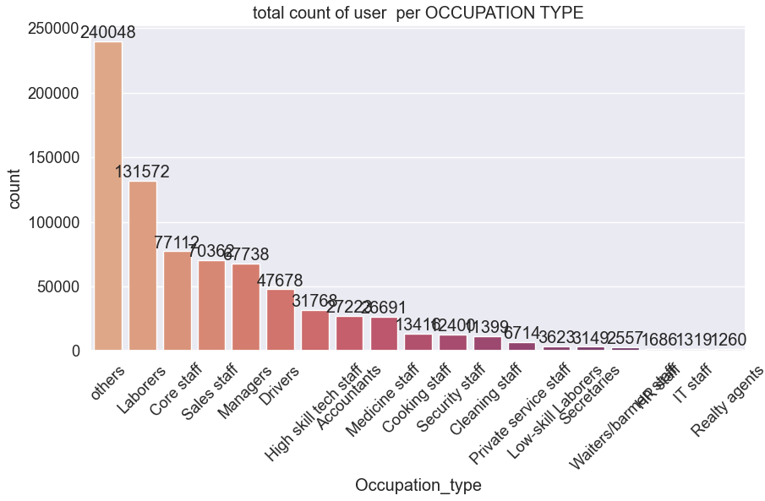
2. Data Understanding (11/11)
Data Exploration (clustering, visualization, etc.)
2) Visualize graphs to show the clustering clearly

Slide 16
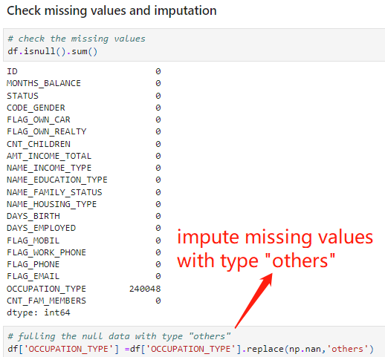
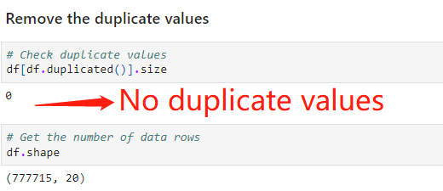
3. Data Preparation (1/7)
Data Preparation/ Cleaning
1) Remove the duplicate values --- no duplicated values
2) Check missing values and imputation --- imputation of missing values

Slide 17
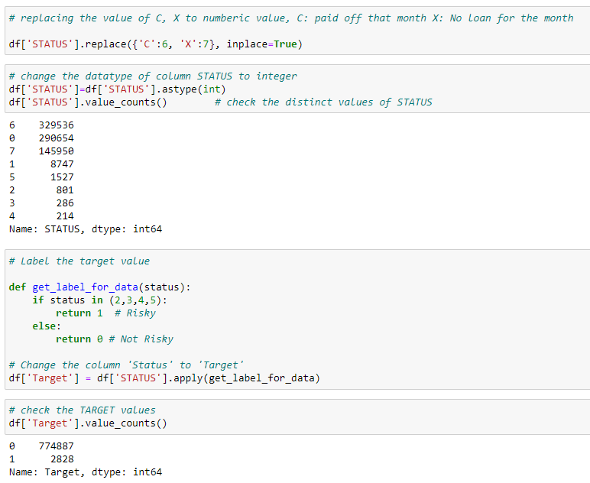
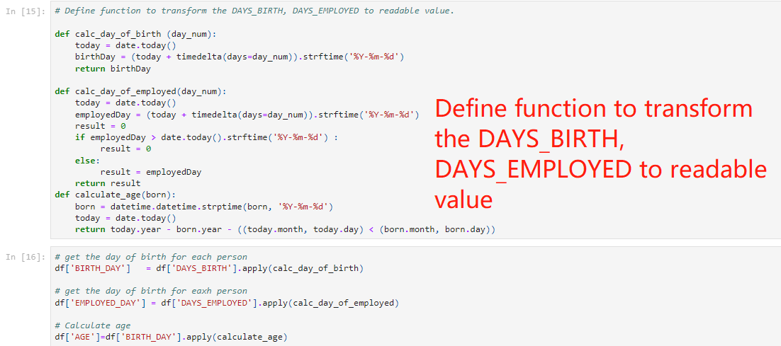
3. Data Preparation (2/7)
Data Preparation/ Cleaning
3) Transform the value in columns to readable values ---Function defined to transform DOB to AGE values
4) Label Target Variable --- Transform the “Status” value and Label the values as “Target”
STATUS:
0: 1-29 days past due
1: 30-59 days past due
2: 60-89 days overdue
3: 90-119 days overdue
4: 120-149 days overdue
5: Overdue or bad debts, write-offs for more than 150 days
C: paid off that month X: No loan for the month

Slide 18
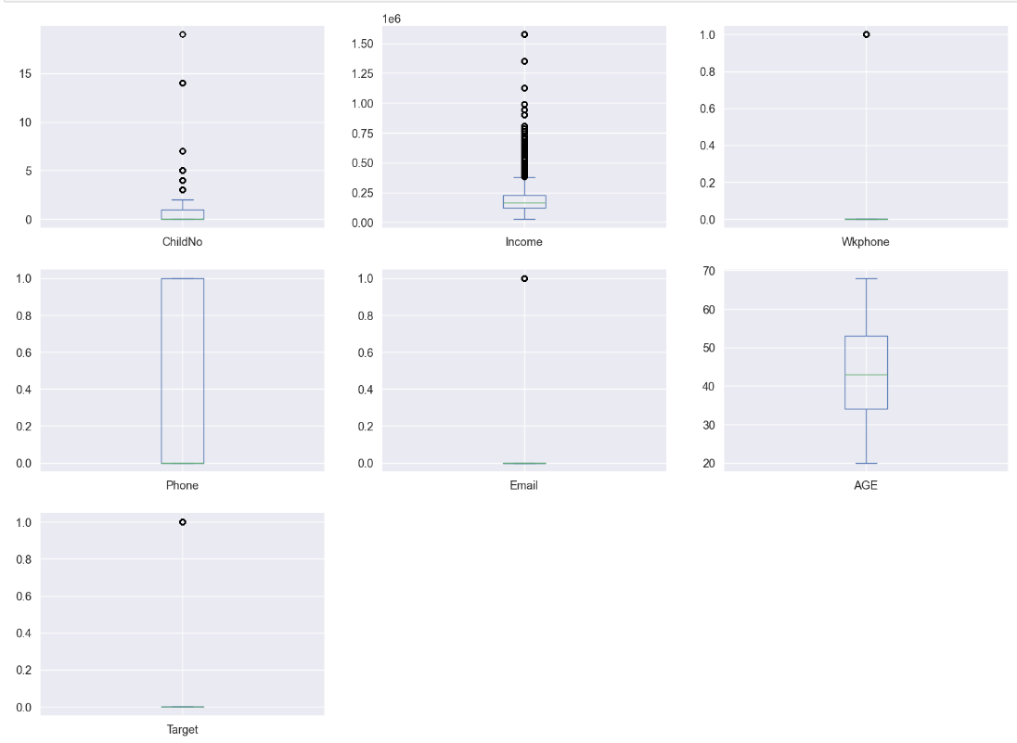
3. Data Preparation (3/7)
Imbalanced Class and Outliers
Plot the boxplot and violin plot to display the distribution and density of data
Box Plot:
Outliers Detecting
Shape of data distribution

Slide 19
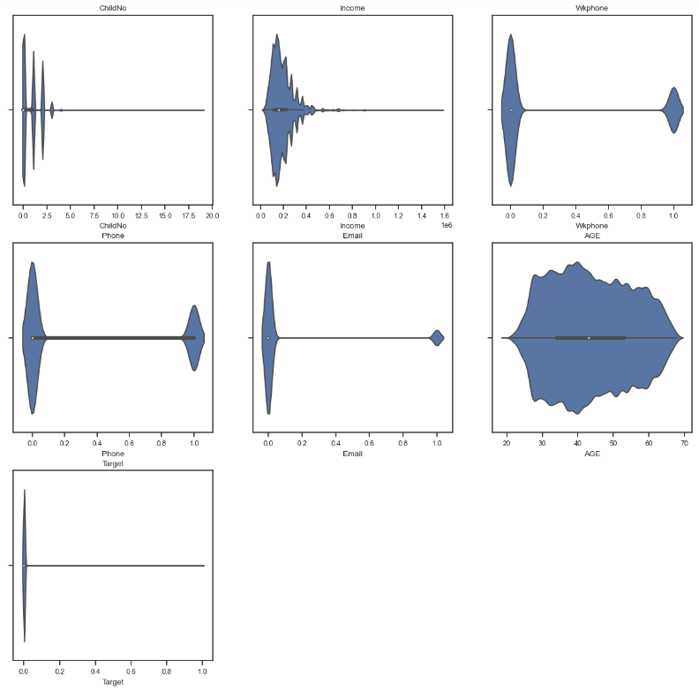
3. Data Preparation (4/7)
Imbalanced Class and Outliers
Plot the boxplot and violin plot to display the distribution and density of data
Violin Plot:
Additional way to check outliers
Shape of data distribution
Imbalance Class of ‘TARGET’ variable

Slide 20
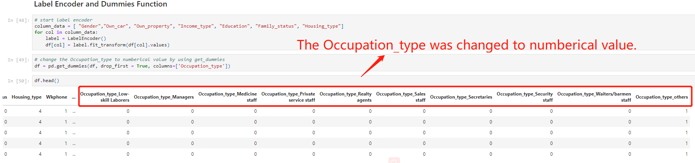
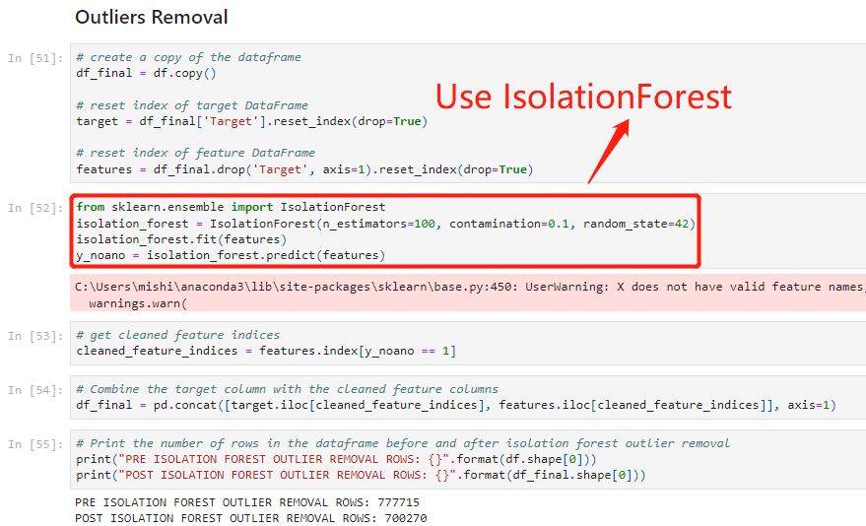
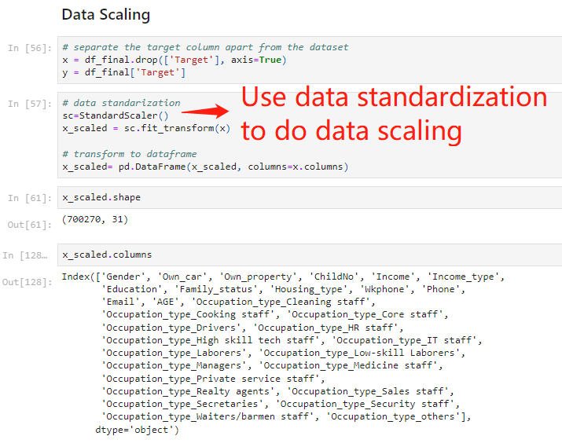
3. Data Preparation (5/7)
Outliers Removal and Label Encoder
Label Encoder and Dummies Function to convert categorical data, the categorical values are changed to numerical values (0 and 1).
Remove outliers by using Isolation Forest
Data scaling is implemented by using data standardization.

Slide 21
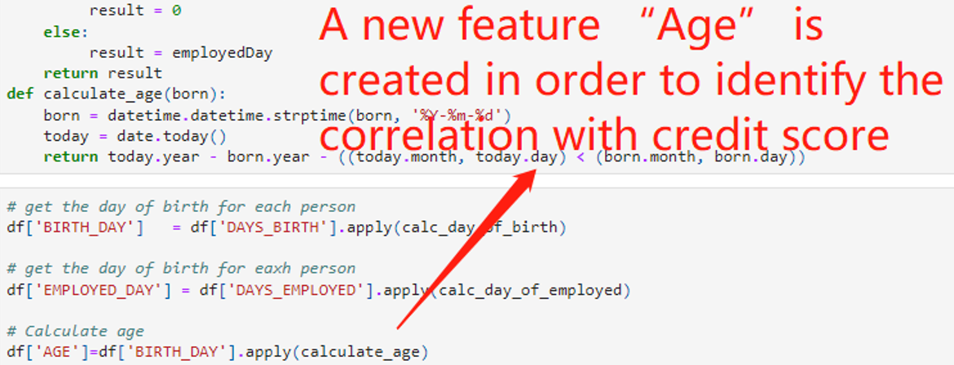
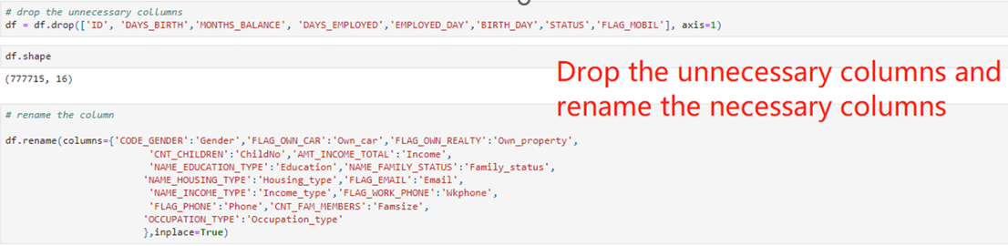
3. Data Preparation (6/7)
Feature Engineering
A new feature “Age” is created in order to identify the correlation with credit score. Firstly, we defined the function to transform the DAYS_BIRTH, DAYS_EMPLOYED to readable value. Then we used the birth date to calculate the ages.
After calculating the age, some unnecessary columns are removed: 'ID','DAYS_BIRTH','MONTHS_BALANCE','DAYS_EMPLOYED','EMPLOYED_DAY','BIRTH_DAY','STATUS','FLAG_MOBIL'

Slide 22
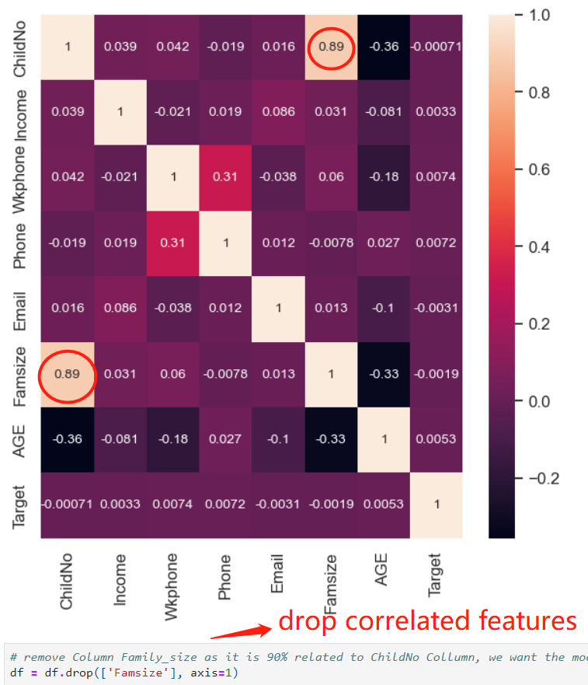
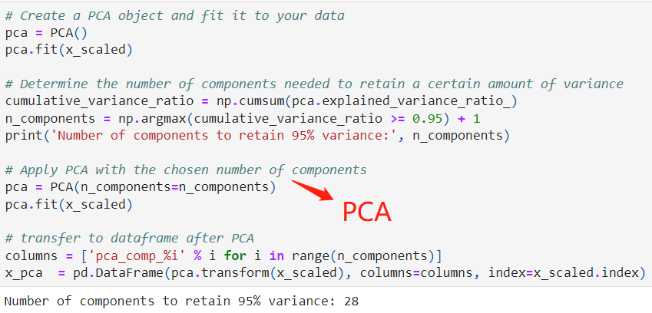
3. Data Preparation (7/7)
Feature Engineering
Use a correlation matrix to check for correlation between predictor variables and drop correlated features
After checking for correlation between predictor variables, Column Family_size was dropped correlated featuresas it is 90% related to ChildNo Collumn.

Slide 23
4. Modeling and Pipelines Creation (1/11)
Pipeline 1: Dataset using PCA to Reduce Dimensionality
Step 1: Using PCA (Best components: 28)
Step2: Data Balancing (Under sampling)
*Oversampling the minority class caused the Gridsearch model executing freezed, so under sampling the majority class is chosen
Step 3: Modeling and Evaluation
Model 1: Logistic Regression
Model 2: KNN (Hyperparameter Tuning)
Model 3: Decision Tree (Hyperparameter Tuning)
Model 4: Decision Tree _BAGGING (Hyperparameter Tuning + Stratified Kfold +Ensemble Learning)
Model 5: Random Forest (Stratified Kfold )
Model 6: XGBoost (Hyperparameter Tuning)
Step 4: Result Analysis
Pipeline 2: Dataset without Using PCA
Step 1: Data Balancing (Under sampling)
Step 2: Modeling and Evaluation
Model 1: Logistic Regression
Model 2: KNN (Hyperparameter Tuning)
Model 3: Decision Tree (Hyperparameter Tuning)
Model 4: Decision Tree _BAGGING (Hyperparameter Tuning + Stratified Kfold +Ensemble Learning)
Model 5: Random Forest (Stratified Kfold )
Model 6: XGBoost (Hyperparameter Tuning)
Step 3: Result Analysis
Pipeline 3: Models with Feature Selection (Dataset with PCA)
Step 1: Using PCA
Step 2: Data Balancing (Under sampling)
Step 3: Modeling and Evaluation
Model 1: Logistic Regression
Model 2: KNN (Hyperparameter Tuning + Feature Selection)
Model 3: Decision Tree (Hyperparameter Tuning + Feature Selection)
Model 4: Random (Hyperparameter Tuning + Feature Selection)
Step 4: Result Analysis

Slide 24
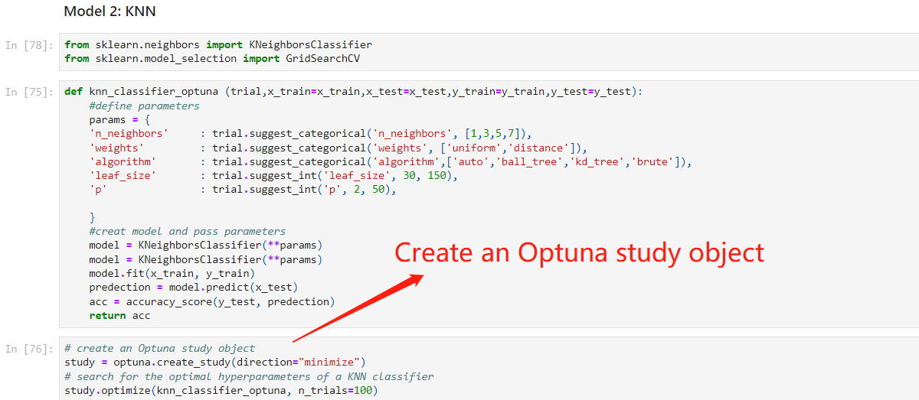
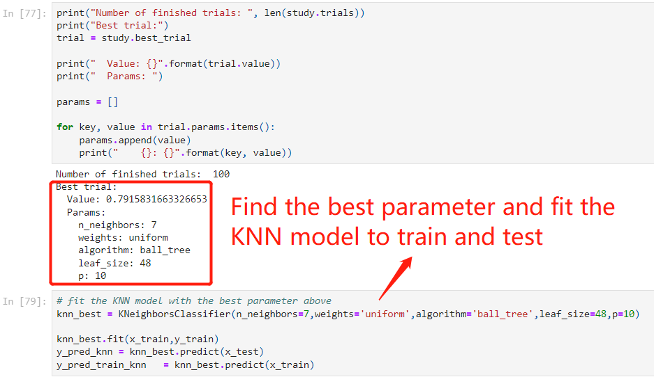
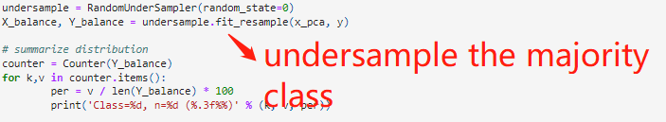
4. Modeling and Pipelines Creation (2/11)
1) Pipeline 1 - Dimensionality Reduction by PCA:
To simplify the complexity of the data while retaining the maximum amount of variability and reduce overfitting
Determined the number of components (28) by setting the variance of 95%+
Applied PCA with the number of components, then transferred to dataframe.
Oversampling the minority class cause the GridSearch model executing freezed, so under-sampling the majority class is chosen for balance the class.
Created 6 models with PCA.
Model 1 is Logistic Regression; Model 2 is KNN (use Optuna library to perform hyperparameter tuning); Model 3 is Decision Tree; Model 4 is Decision Tree + Kfold + Bagging; Model 5 is Random Forest; Model 6 is XGBoost.

Slide 25
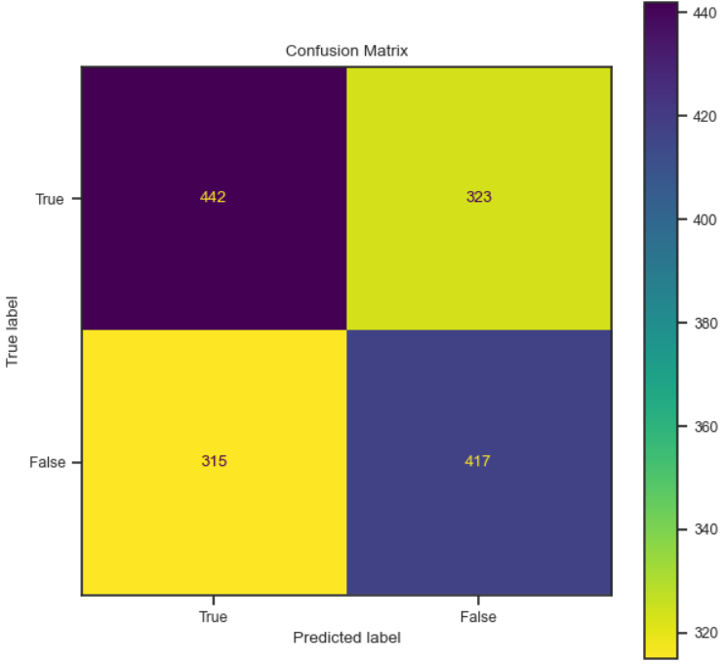
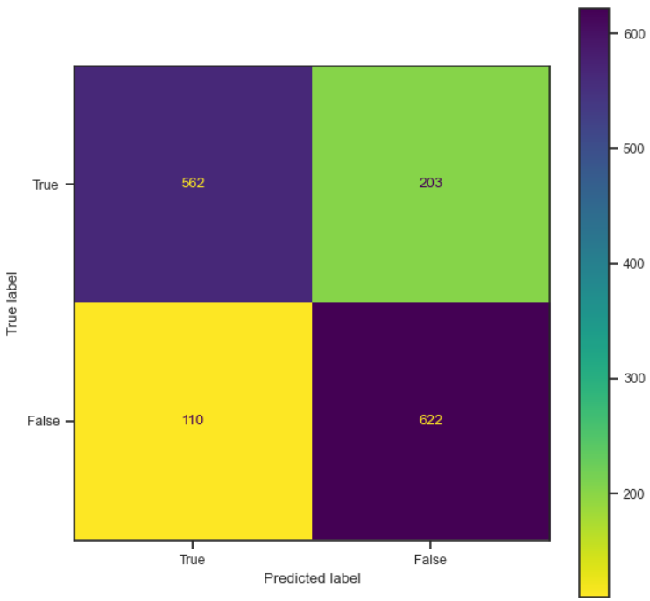
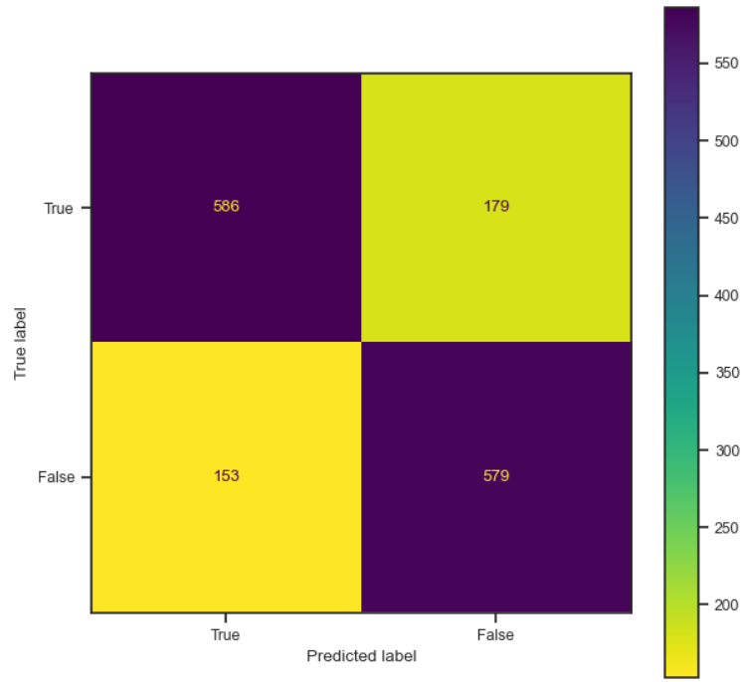
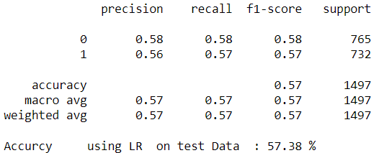
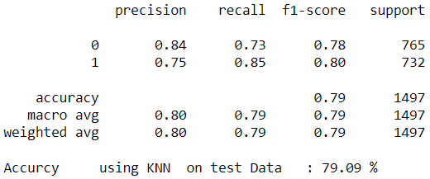
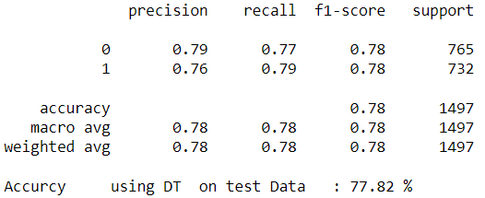
4. Modeling and Pipelines Creation (3/11)
Pipelines creation and rationale behind it
Pipeline 1 - Dimensionally Reduction by PCA:
Model 1: Logistic Regression Model 2: KNN Model 3: Decision Tree

Slide 26
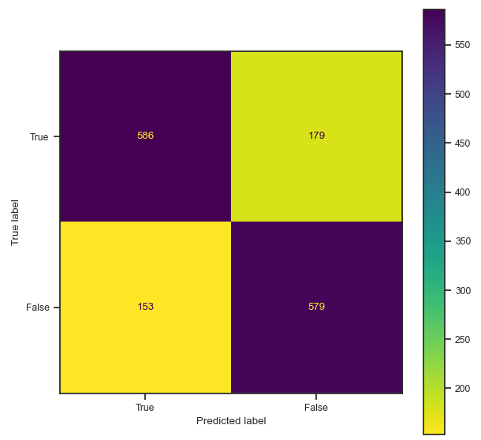
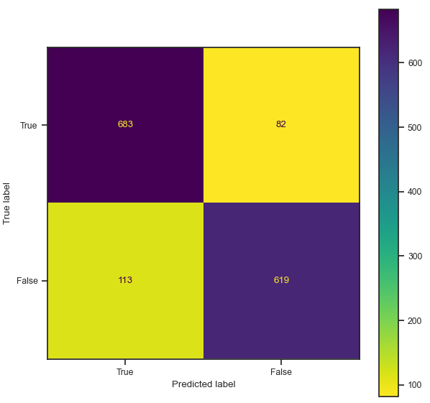
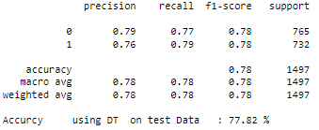
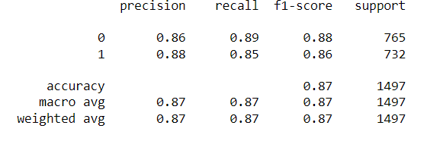
4. Modeling and Pipelines Creation (4/11)
1) Pipeline 1 - Dimensionally Reduction by PCA:
Comparison between Model 3 and Model 4 to see the difference after bagging.
Decision Tree Decision Tree + KFold + Bagging

Slide 27
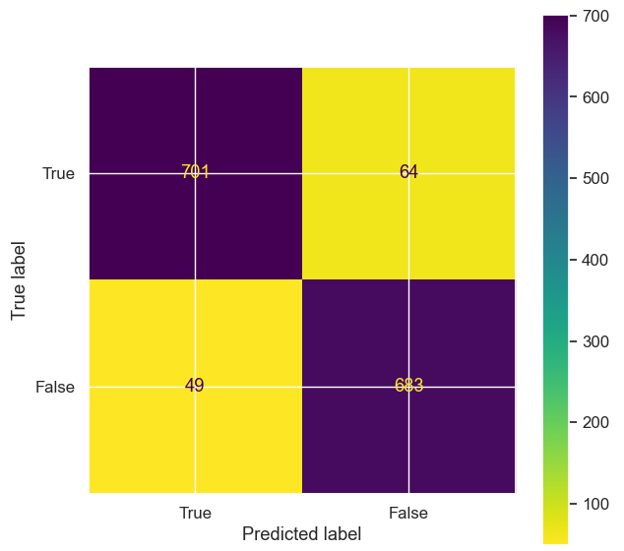
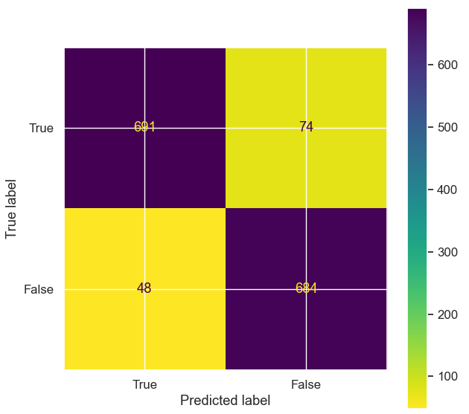
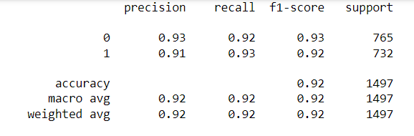
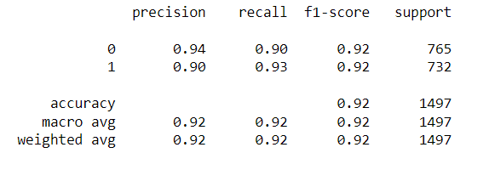
4. Modeling and Pipelines Creation (5/11)
1) Pipeline 1 - Dimensionally Reduction by PCA:
Model 5: Random Forest Model 6: XGBoost.

Slide 28
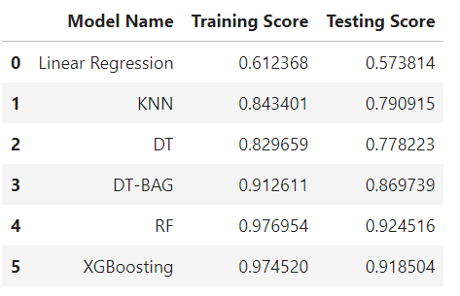
4. Modeling and Pipelines Creation (6/11)
1) Pipeline 1 - Dimensionally Reduction by PCA:
Training and Testing Scores
Random Forest model has the highest training and testing scores, indicating that it is the best performing model among the models that were evaluated.
The Linear Regression model has the lowest training and testing scores, suggesting that it is not a good fit for the dataset.
Decision Tree with Bagging, and XGBoost, also have relatively high training and testing scores, indicating that they may be viable alternatives to the Random Forest model.

Slide 29
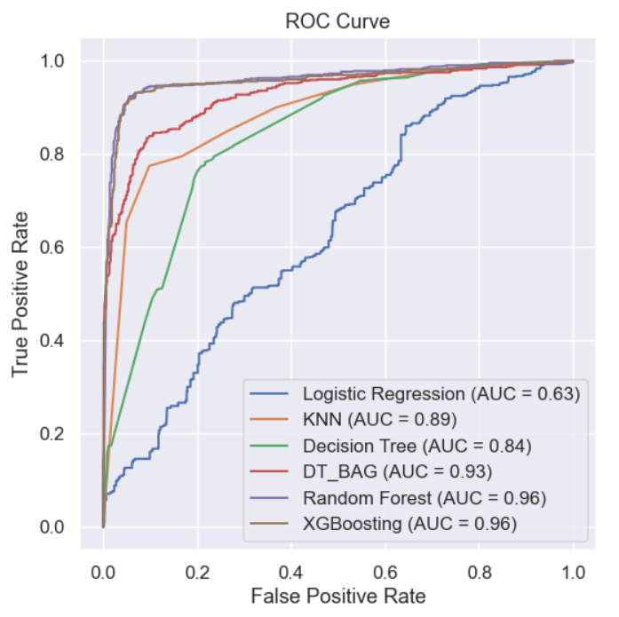
4. Modeling and Pipelines Creation (7/11)
1) Pipeline 1 - Dimensionally Reduction by PCA:
ROC Curve and AUC Scores
Random Forest model and XGBoost model have the highest AUC score, indicating they have the best overall performance compared to other models.
Logistic Regression and KNN models have the lowest AUC scores, indicating their performance are relatively poor compared to other models.

Slide 30
4. Modeling and Pipelines Creation (8/11)
2) Pipeline 2 – Dataset without PCA:
We did another Pipeline without PCA in comparison with the first Pipeline using PCA.
After balancing the data, we created the same 6 models as above without using PCA.

Slide 31
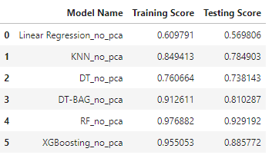
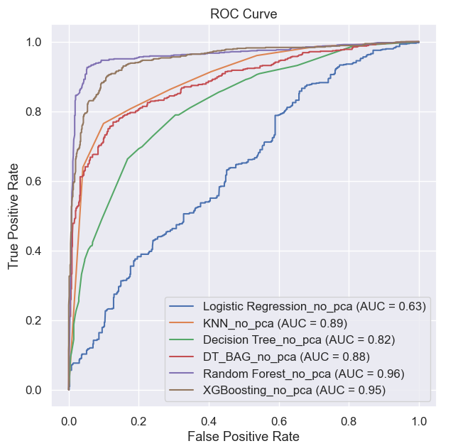
4. Modeling and Pipelines Creation (8/11)
Random Forest model has the highest AUC score, indicating it has best overall performance compared to other models.
Logistic Regression and Decision Tree models have the lowest AUC score, indicating their performance is relatively poor compared to other models.

Slide 32

4. Modeling and Pipelines Creation (9/11)
3) Pipeline 3 - Models with Feature Selection (Dataset with PCA)
a) In this Pipeline, we created feature selections on 4 models.
b) Each model performs a grid search to find the best parameters.
c) Fit these selected columns to train and test the model.
Model 1: Logistic Regression with Feature Selection, Number of Feature selected: 20.
Model 2: Random Forest with Feature Selection, Number of Feature selected: 20.
Model 3: Decision Tree with Feature Selection, Number of Feature selected: 15.
Model 4: KNN with Feature Selection, Number of Feature selected: 15.

Slide 33


4. Modeling and Pipelines Creation (10/11)
Pipelines creation and rationale behind it (at least 3)
3) Pipeline 3 - Models with Feature Selection (Dataset with PCA)
Training and Testing Scores ROC Curve and AUC Scores
DT model has the best accuracy score compared to others, and KNN followed, Random Forest not perform well per the scores.
However, KNN model and Random Forest model have the highest AUC score, indicating they have best overall performance compared to other models.
Logistic Regression has the lowest AUC score, indicating its performance is relatively poor compared to other models.

Slide 34
4. Modeling and Pipelines Creation (11/11)
Hyperparameter tuning
We used two different types of hyperparameter tuning methods in this project:
In KNN model: we used Optuna for hyperparameter optimization
In Decision Tree, DT-KFOLD, DT-BAGGING, Random Forest, XGBoost models: We used GridSearchCV for the best value of hyperparameter
Ensemble Learning
We used two types of ensemble learning in this project: DT-BAGGING and XGBoost
Models | Hyperparameter Tuning | Ensemble Learning
Logistic Regression
KNN | YES Optuna
Decision Tree | YES GridSearch
Decision Tree + Bagging | YES GridSearch | YES
Random Forest |  | YES
XGBoost | YES GridSearch | YES

Slide 35
5. Model Evaluation and Selection (1/5)
Evaluation metrics
We evaluate the models by:
Comparing the accuracy scores of training scores and testing scores in different models.
Plotting ROC curves for each model.
Notes:
What we can see from the previous slides, there are 6 models in Pipeline 1, 6 models in Pipeline 2 and 4 models in Pipeline 3. So totally 16 models need to be evaluated.
We choose to compare the accuracy scores of training scores and testing scores in different models and plot ROC curves for each model.

Slide 36
5. Model Evaluation and Selection (3/5)
Model Selection Analysis_Accuracy score analysis
# | Model Name | Pipeline 1 | Pipeline 2 | Pipeline 3
# | Model Name | Testing Score(PCA) | Testing Score(No PCA) | Testing Score(Feature Selection)
0 | Linear Regression | 0.573814 | 0.569806 | 0.581162
1 | KNN | 0.790915 | 0.784903 | 0.869071
2 | DT | 0.778223 | 0.738143 | 0.875752
3 | DT-BAG | 0.869739 | 0.810287 | NaN
4 | RF | 0.924516 | 0.929192 | 0.847027
5 | XGBoost | 0.918504 | 0.885772 | NaN
Linear Regression performed not well in all Pipelines no matter with PCA or feature selection, and it had the lowest testing scores, which means that this model doesn’t fit for the data.
KNN and DT are visibly getting better performance in Pipeline 3 with feature selection.
RF in Pipeline 2 is the most suitable model for the credit card approval data, RF in Pipeline 1 is second rank and XGBoost is third rank in this Accuracy score chart.
Notes:
Linear Regression performed not well in all Pipelines no matter with PCA or feature selection (below 60%), had the lowest training and testing scores, which means that this model doesn’t fit for the data.
KNN and DT are visibly getting better performance in Pipeline 3 with feature selection (from below 80% to above 85%).
RF in Pipeline 2 is the most suitable model for the credit card approval data., RF in Pipeline 1 is second rank and XGBoost is third rank in Accuracy score here.

Slide 37
5. Model Evaluation and Selection (4/5)
Model Selection Analysis _ ROC curve result analysis
Pipeline 1 Pipeline 2 Pipeline 3
Testing Score (PCA) Testing Score (No PCA) Testing Score (Feature Selection)
Random Forest model had the highest testing score for the "No PCA“/Pipeline 2 and "with PCA“/Pipeline 1 scenarios.
DT model had the highest testing score for the "Feature Selection“/Pipeline 3 scenario over DT model in Pipeline 1 and Pipeline 2 scenarios.
Logistic Regression and KNN models have the lowest AUC score, indicating their performance is relatively poor compared to other models.
Notes:
From ROC chart, we can see that Random Forest model had the highest testing score for the "No PCA“/Pipeline 2 and "with PCA“/Pipeline 1 scenarios.
DT model had the highest testing score for the "Feature Selection“/Pipeline 3 scenario over DT model in Pipeline 1 and Pipeline 2 scenarios. Feature selection is useful for DT.
Logistic Regression and KNN models have the lowest AUC score, indicating their performance is relatively poor compared to other models.

Slide 38
5. Model Evaluation and Selection (5/5)
Model Selection Analysis_ Overall
ROC curve and accuracy scores both indicate the Pipeline 1 with PCA in which the models can achieve the best performance than Pipeline 2 without PCA.
Among all these scenarios, Random forest in Pipeline 2 reached the best score in both AUC (0.925) and accuracy score (0.929).
So, the result suggests that:
The Random Forest model in Pipeline 2 may be the most effective for this particular dataset and problem.
Random Forest model in Pipeline 1 and XGBoost model in Pipeline 1 also perform well, so that both of them can be considered as an alternative or backup option.

Slide 39

5. Model Evaluation and Selection (2/5)
Feature Importance of RF model:
Among all the occupations, secretaries and sales have the highest importance scores, which means they are more related with the results compare to other features.
We also find that gender, owning a car, income and education are not quite much affected the final score.
Notes:
Results interpretation
From the accuracy scores chart, we can see that linear regression had the lowest training and testing scores, which means that this model doesn’t fit for the data. On the other hand, Random Forest model had the highest training and testing score for the "No PCA" and "with PCA" scenarios, meaning that it’s the most suitable model for the credit card approval data.
From ROC chart, we can see that Random Forest model had the highest testing score for the "No PCA" and "with PCA" scenarios, while the DT model had the highest testing score for the "Feature Selection" scenario. It indicates that they have the best overall performance compared to other models. On the other hand, Logistic Regression and KNN models have the lowest AUC score, indicating their performance is relatively poor compared to other models.
It appears that the Random Forest model had the highest testing score for the "No PCA" and "with PCA" scenarios, while the DT model had the highest testing score for the "Feature Selection" scenario.
Apart from that, the ROC curves in 3 Pipelines also show that the Random Forest model in Pipeline 2 has the best performance.

Slide 40

6. Conclusion
Results analysis
1) Random Forest model in Pipeline 2 had the best performance among all the models.
2) Random Forest model in Pipeline 1 and XGBoost model in Pipeline 1 can be considered as an alternative or backup option.
Notes:
Results analysis
We prepared the data and implemented feature engineering, created three Pipelines, and trained and tested the data using six models for the first two Pipelines and four models for the third Pipeline. We compared the performance of these models by calculating accuracy scores and plotting the ROC chart. The Random Forest model in Pipeline 2 had the best performance among all the models. The RF model in Pipeline 1 and XGBoost in Pipeline 1 can be alternative choices if other specific requirements need to be considered in reality.

Slide 41
6. Conclusion
Recommendations
“Occupation type” may have a larger impact on the final score of the model compared to other factors. So, we recommend the banks to consider more on the occupations of the applicants when they applied for the credit card.
Notes:
After plotting the features, we found that “Occupation” has the highest correlation with the credit scores. Among all the occupations, secretaries and sales have the highest importance scores, which means they are heavily related with the results. We also find that gender, owning a car, income and education are not quite related with credit scores. Based on the findings, we recommend the banks to consider more on the occupations of the applicants instead of other factors.

Slide 42

Thank you!
PROJECT TIMELINE
PAGE NUMBER

